Slide 1
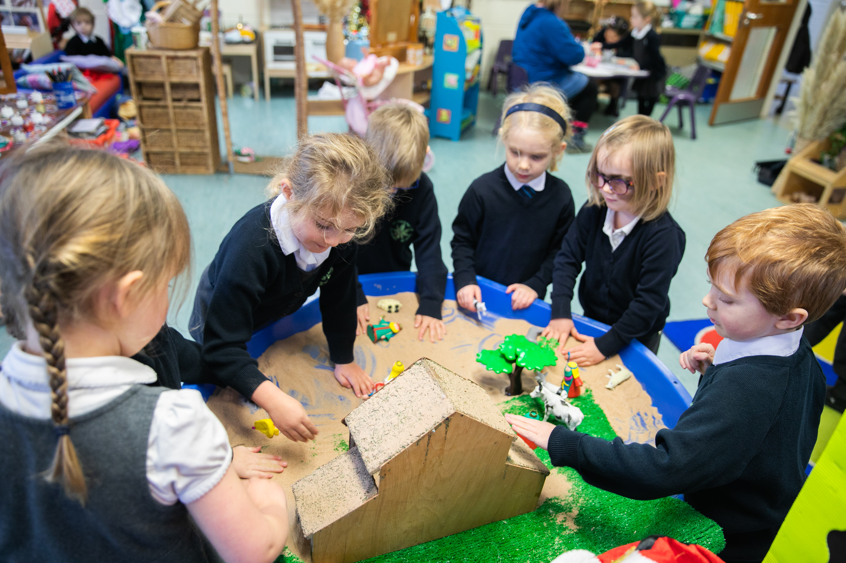
Continuous Provision and Independent Learning

Slide 2
Why Continuous Provision?
As a school, we recognise that children who are now in KS1, have suffered from the effects of Covid and lockdown in that they have missed chunks of vital time in nursery when they would have been socialising and interacting with children their own age.
We also recognise that transitioning from EYFS to Year 1 (mixed with Year 2s) is a big step and we want our children to
Children of this age still need opportunities to explore and develop in a creative way.

Slide 3
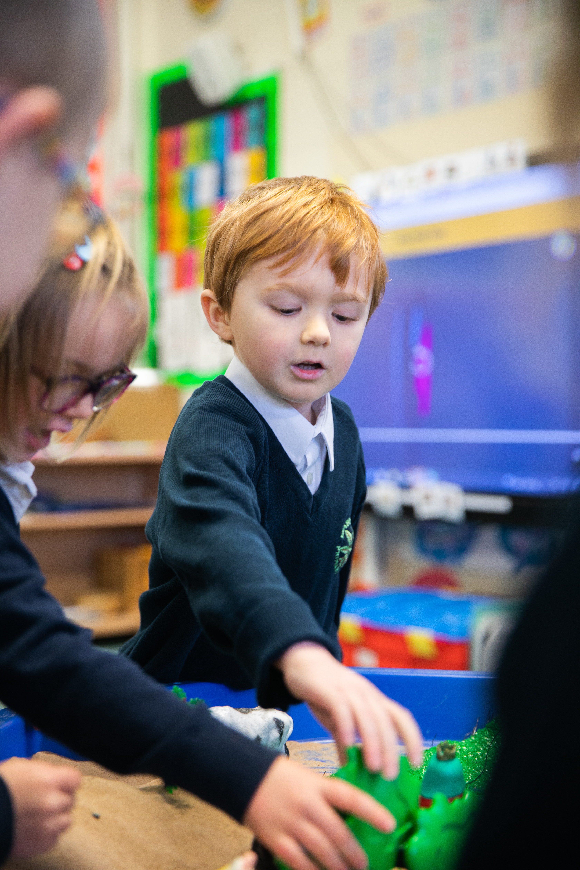
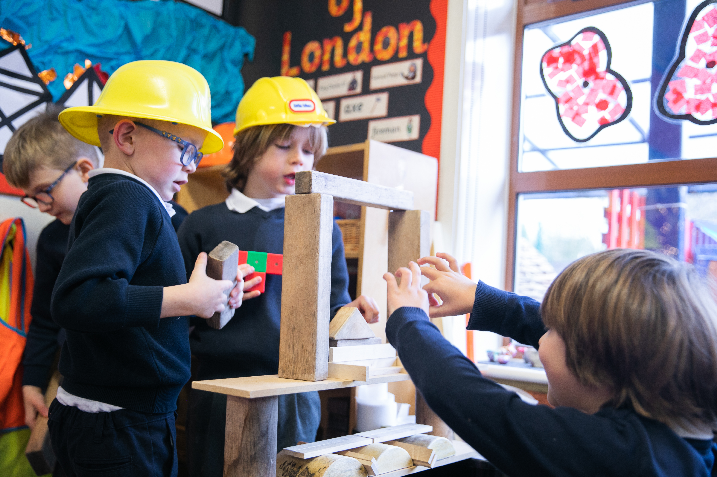
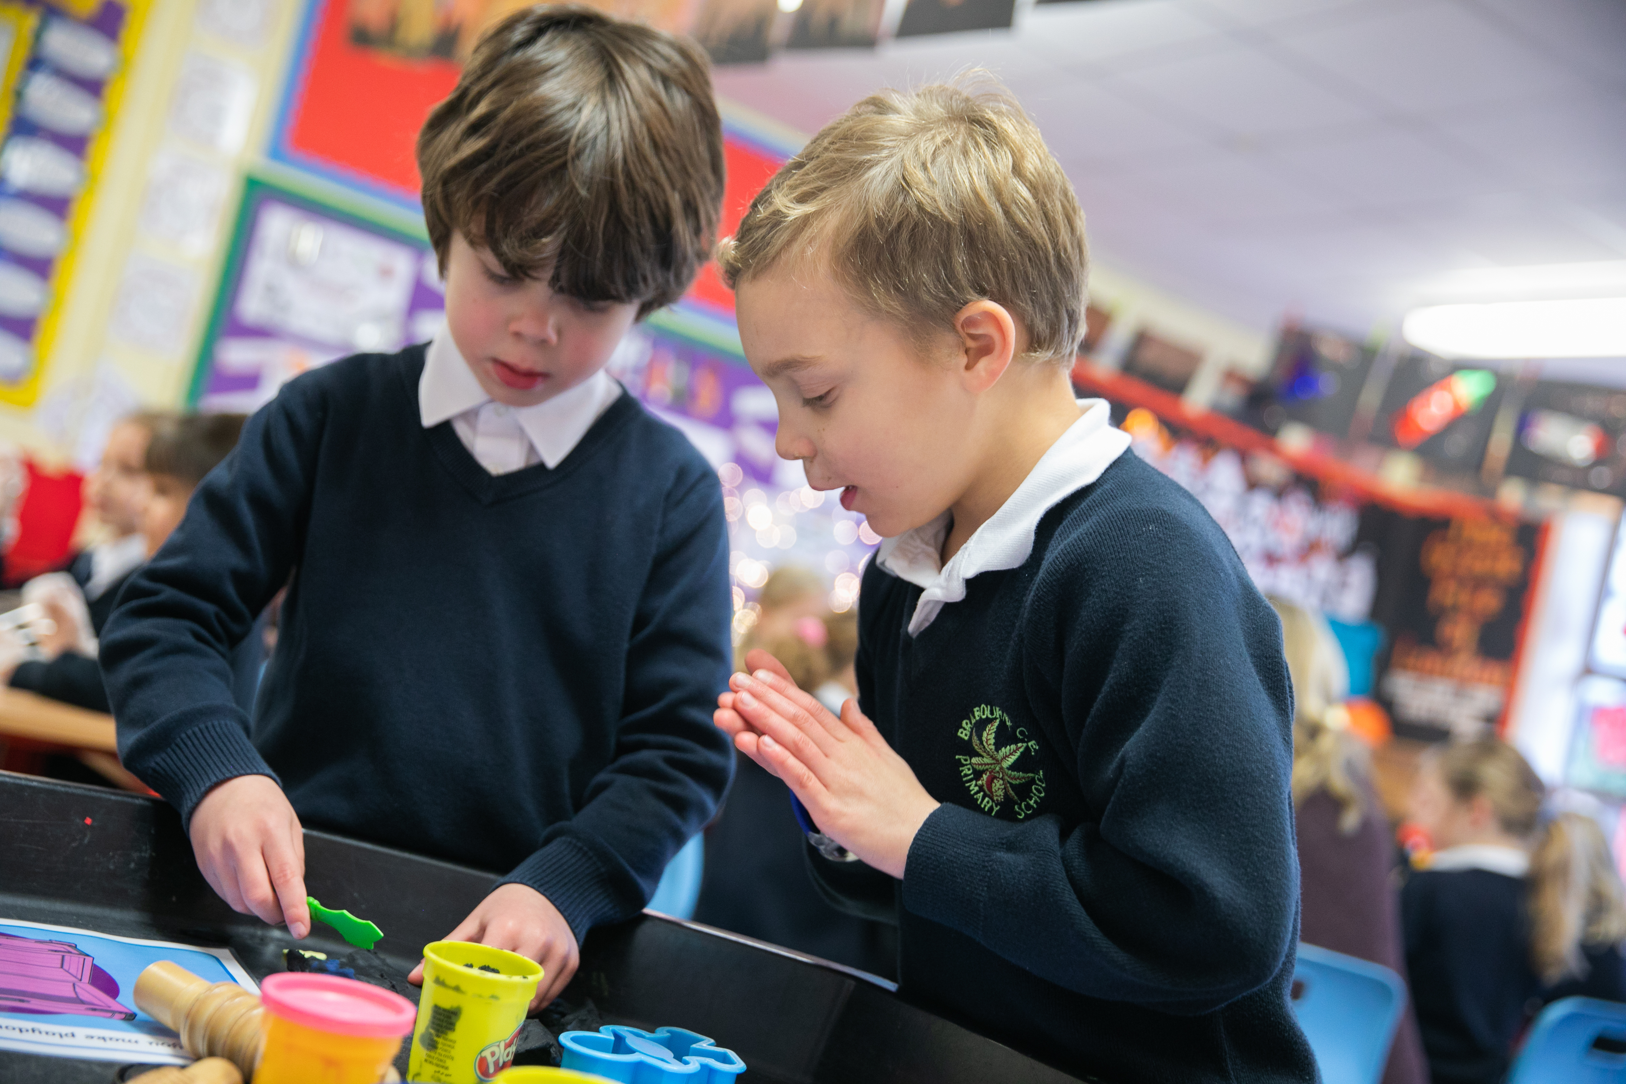

Slide 4
What is Continuous Provision?
CP refers to the resources which are always available within the setting of the classroom for the children to access, such as paint, brushes, paper, junk modelling, books, maths resources, pens, pencils etc.
The consistency of the Continuous Provision allows children to explore their interests, start projects or consolidate learning. It also encourages children to become active and independent learners.

Slide 5
To extend children’s learning and maintain interest, the continuous provision is enhanced with resources or challenges that link any topics or themes. For example, if our topic was on the Seaside, an enhanced provision maybe designing a bathing machine or painting a picture in the style of an artist.
Other enhanced provision could be challenges that link to previous or recent learning, eg: part part whole in Maths.
Enhanced provision is changed regularly to keep children interested in their learning.

Slide 6
Independent Learning in Continuous Provision
Children get many opportunities to explore and learn in Continuous Provision and we call this Independent Learning time.
Children will understand the routines and boundaries for Independent Learning Time and time is spent making the children aware of these routines and expectations.
Children get approx 2.5 hours (Year 1) and 1.5 hours (Year 2) across the day to explore and learn in Independent Learning Time

Slide 7
Independent Learning Journals
Children document their work in Independent Learning Time in their Independent Learning Journals. These books are not marked, but are an extension to the adult led work that is completed during the day.

Slide 8
Benefits of Continuous Provision and Independent Learning Time
Challenges thinking and helps embed concepts.
Allows children to become critical thinkers, independent learners and builds resilience.
Develops problem solving skills.
Children develop self-awareness, manage their feelings and behaviour and form positive relationships.
Learning conversations between children and adults with rich opportunities of modelling and extending speech and vocabulary.
Builds and develops skills within all areas of the National Curriculum.
Enables the Teacher to teach smaller adult led groups and give young children the quality time, attention and support they need.

Slide 9
Any Questions?

