Slide 1
Science - Year 3/4B Summer 1
Animals including humans
The Circle of Life
Session 5
Teaching PowerPoint
© Original resource copyright Hamilton Trust, who give permission for it to be adapted as wished by individual users.
We refer you to our warning, at the foot of the block overview, about links to other websites.

Slide 2
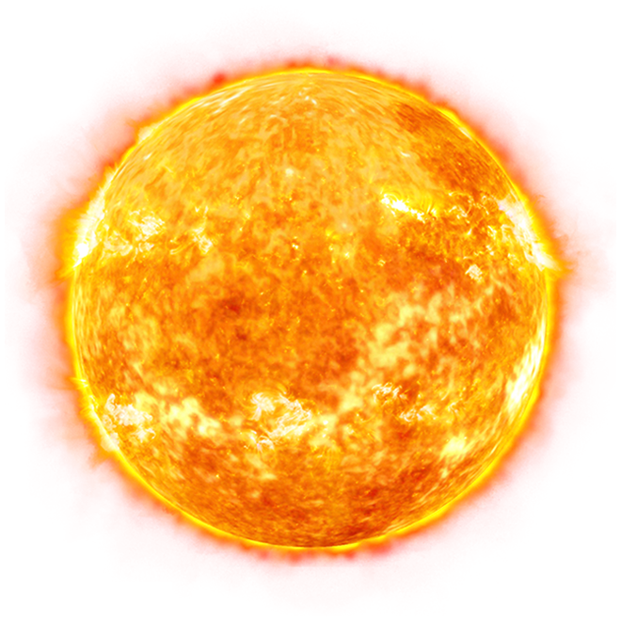
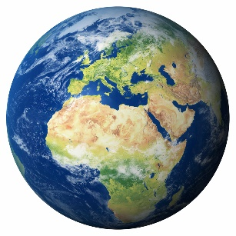
Where does all energy on planet Earth come from?
The Sun
How far away is the sun?
About 93 million miles!

Slide 3
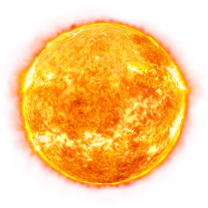
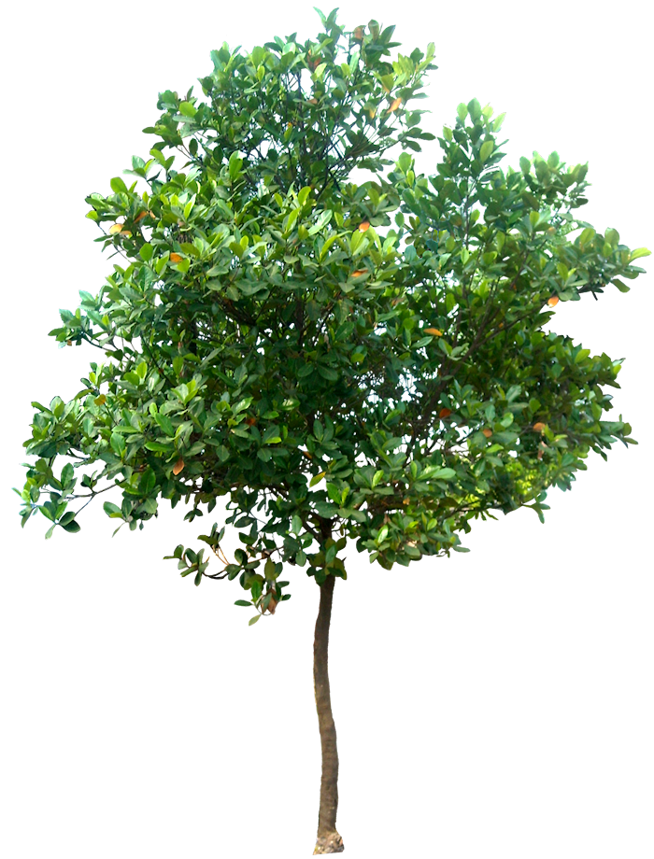
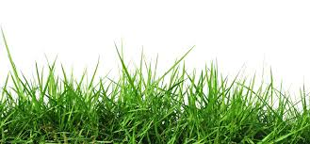
Green plants use sunlight to make their food. What is this process called?
Photosynthesis
Green plants are called Producers because they produce their own food.

Slide 4
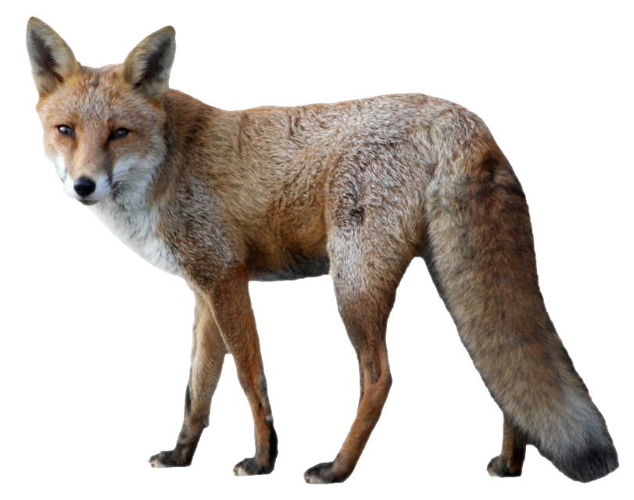
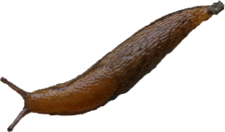
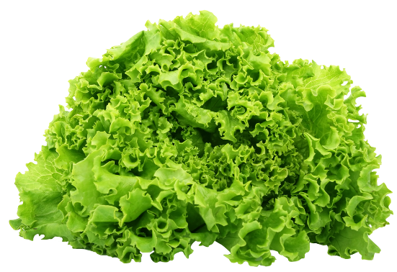
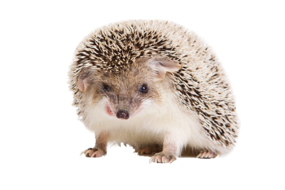
What feeds what?
Starting with the sun, put these in order in the food chain
The energy is being transferred from creature to creature and the arrows show the direction it is going
The sun provides the energy for the lettuce to grow
The hedgehog eats the slug
The slug eats the lettuce
The fox eats the hedgehog

Slide 5
Let’s take a closer look at this Food Chain
What is the Producer?
What is the Primary Consumer?
What is the Secondary Consumer?
What is the Top Predator?

Slide 6
Which animals are predators?
Which animals are prey?
I’m prey to the hedgehog
and I’m a predator of the hedgehog
I’m a predator of the slug
and I’m prey to the fox

Slide 7
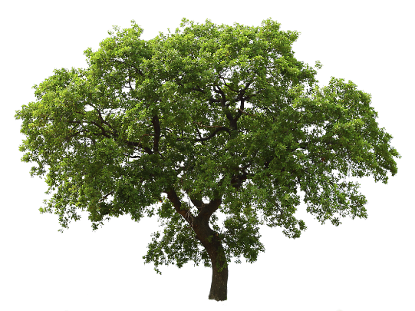
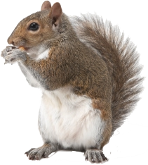
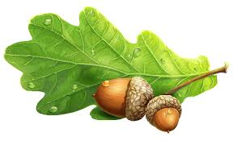
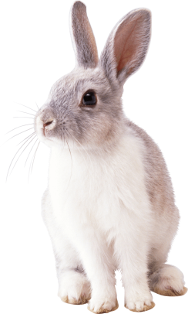
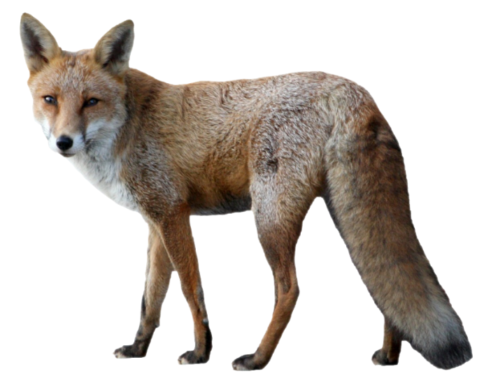
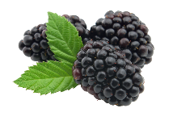
In reality though, most animals eat more than one thing so a food chain is really more of a food web!

Slide 8
Look closely at this food web and use it to answer the following questions:
Who are the predators of the squirrel?
The fox and the hawk
How many producers are shown?
Which are the top predators?
Who are the secondary consumers?
Who is the hedgehog’s prey?
Who are the primary consumers?
The fox and the hawk (because nobody eats them)
The slug
4
(all the plants)
Every animal except the hawk (because they all eat plants)
The hawk, the fox and the hedgehog

Slide 9
You might be wondering how the same animal can be both a primary and a secondary consumer.
Think about the hedgehog in this food chain. Is it a primary or secondary consumer?
A primary consumer because it is eating a producer (the blackberries).
What is the hedgehog in this food chain?
A secondary consumer because it is eating a primary consumer (the slug).

Slide 10
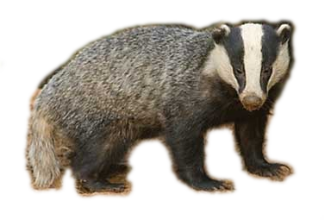
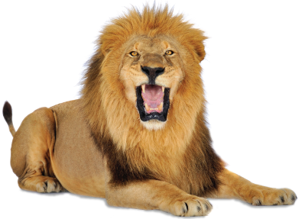
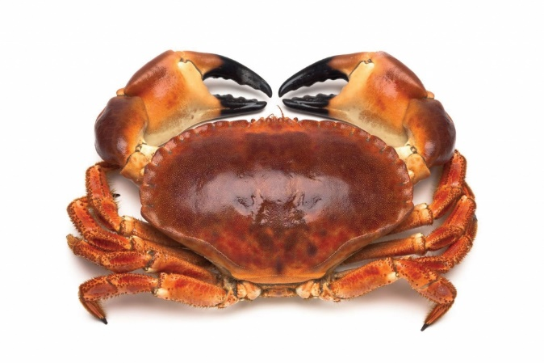
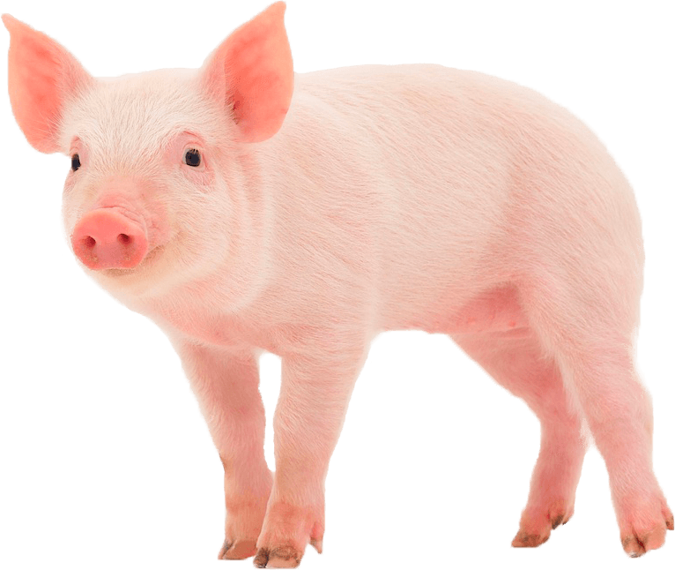
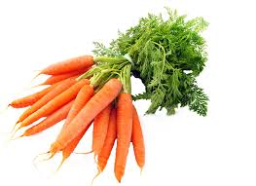
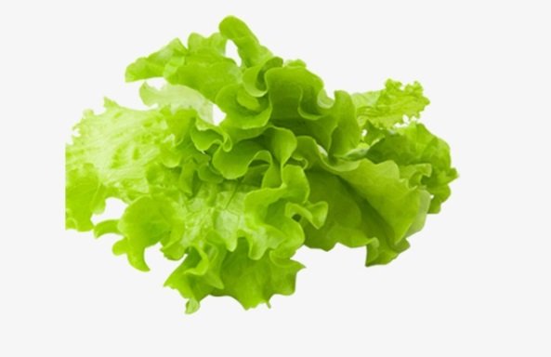
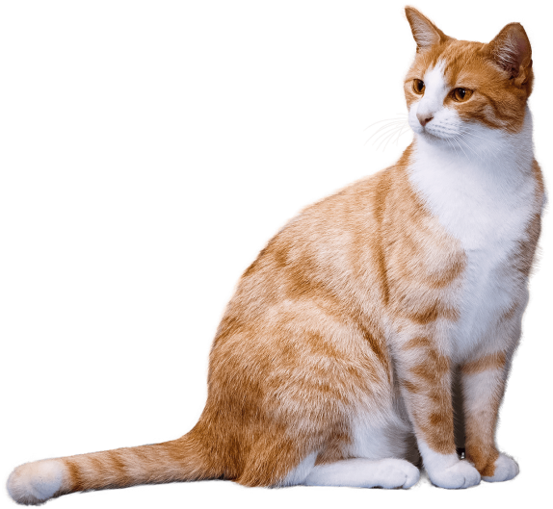
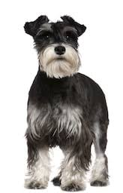
Wow! What a lot you’ve learnt about food chains and food webs. Now it’s time to make your own!

