Slide 1
Jupiter Class
Learning from Home
Term 5 Week 5/Term 1 Week 1
Hi all,
Thank you so much for anyone who has sent me work they’ve completed at home. I absolutely love seeing and reading what you’ve done and enjoyed keeping in touch. I’m really proud of all of the work I’ve seen so far, keep it up!
Thank you everyone who has also sent me quizzes on the UK – I think maybe I need to do a bit more learning about it in order to keep up with you all!
Here is a suggestion of how you might tackle the tasks:
9.00 – 9.45 PE with Joe Wicks or a daily exercise.
9.45 – 10.30 Maths
10.30 – 11.00 Break
11.00 – 12.00 English
12.00 – 1.00 Lunch
1.00 – 2.00 Topic
Reading should be happening everyday and I’ve popped up a link to a really good website for you to take a look at.
Don’t forget to email me if you have any questions or just to simply show me your work so far.
I really miss you all and hope you are keeping happy, safe and well.
Looking forward to seeing you all soon,
Mrs B

Slide 2
Maths
The links to Maths home learning are below. Mr Stapley will be uploading the printable worksheets on our school website once they become available.
Year 5: https://whiterosemaths.com/homelearning/year-5/
You will be learning to add and subtract fractions.
Year 6: https://whiterosemaths.com/homelearning/year-6/
You will be learning to multiply fractions to begin with, some good revision for you all!
You’ll start each lesson with flashback four just like we would in class. Then download Get the Activity and either print off or write your answers down on a separate piece of paper (for some questions you may need to print off to do the working out). At the end, you can Get the Answers and mark you work.
It would be really useful if you wrote down – maybe in your planner – anything you really struggled with or didn’t understand; that way, when we go back we can go over anything you were unsure of.
I will also be setting Mathletics which should compliment the White Rose learning you will be doing.

Slide 3
​"There was once a boy, quite ordinary like any other, he lived in an old forest cabin with his mute grandmother. There weren't many things a lonely, young boy like him could do so he went for long forest walks hoping he would find something new"
English
You’ll need to download and print a copy of the activity book. Follow the instructions and watch the video clip https://www.literacyshed.com/blackhat.html#
There are 6 task you can complete once you have completed the activities.
Again, I would love to see and read your work so please email it to me.

Slide 4
Topic – Me, myself and I
Topic: Humans
You will be spending the next few weeks looking at humans and the human body. That will include being and staying healthy and different functions of the human body. Please remember that this is a range of tasks and I would not expect you to complete them all.
Healthy Eating
On a healthy eating plate template, record (drawings, pictures or words) a ‘normal’ days worth of food. What do you notice about what you eat? Should you eat more or less of a particular food group?
Poster
Create a poster on the importance of exercise. What is it’s impact on the body and mind? Is it’s impact important?
The Heart
https://www.bbc.co.uk/bitesize/clips/z9dg9j6
Watch the clip above and read through slides 1 – 3 on the Human Circulatory System PPT on the school website. Print off or draw and label the human heart system based on what you have found out.
The Human Body
Do you know the body as well as you think you do? Print of the worksheet: Major organs of the human body and complete the worksheet.
Mystery Breakfast Maths Game
Dear Diary…
Over 3 days, write a food diary of everything you eat and any exercise you do. Write a summary thinking carefully about what you found. Are you more or less active than you thought? Do you eat a balanced diet? Is there anything you could or would like to change?
Mexican Bean Burger Comprehension
Choose one two or three starts for different levels of difficulty (*** = hardest).
Healthy Eating
From what you know about healthy eating, make a healthy meal or snack. Write the recipe and method down. Think carefully about the ingredients that go into it and how it is or isn’t healthy e.g. in baking, sugar and butter is usually used, can these be substituted to make it a healthier treat?
The Human Circulatory System
Complete slides 3 – 8 on the Human Circulatory System.
Read through the PowerPoint slides and complete the attached activities on: the lungs and the air sacs.
There are lots of videos online, some of these might help your understanding:
https://www.bbc.co.uk/bitesize/topics/zwdr6yc
https://www.bbc.co.uk/teach/class-clips-video/science-ks2-respiration-how-is-oxygen-transported-round-the-body/z7t8qp3
https://www.bbc.co.uk/bitesize/topics/zv9qhyc/articles/zdfs47h
Healthy Easting Multiplication Mosaic activity
Useful diet websites
What should I be eating/drinking? Trust me I’m a Doctor, BBC:
http://www.bbc.co.uk/programmes/articles/1yV5MBkc2Y6pQSWyMgR21y2/what- should-i-be-eating-drinking
Food and diet, NHS:
http://www.nhs.uk/livewell/goodfood/Pages/Goodfoodhome.aspx
Heathy Eating, British Heart Foundation:
https://www.bhf.org.uk/heart-health/preventing-heart-disease/healthy-eating

Slide 5
Have you started this?
Make sure you photograph or record what you’ve done for Mrs Cresswell!

Slide 6
Suggested Reading Books
Take a look at the following website: www.booksfortopics.com
It has a really useful tool that suggests books you might like if you like a particular author www.booksfortopics.com/branchingout
It also has ‘storytime’ on there if you want to listen to a book www.booksfortopics.com/storytime-online
In addition there is: book of the month, new books, book giveaways and suggested books for each Year group.
I’d love to know if you read or have read any of them and what you thought so please do email me a message with your ‘review’.

Slide 7
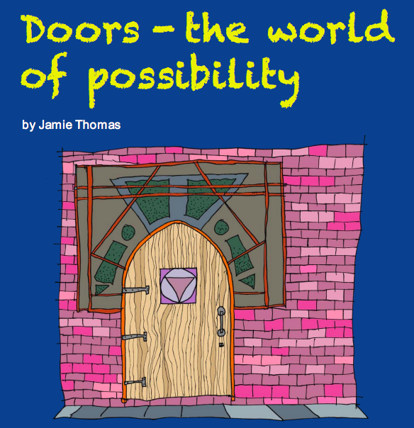
Story Writing
Year 5 and 6 will both be planning and writing a story. Please download from the link or the school website and print off the booklets below which will guide you through. Please email me a copy of your completed story either by taking a picture or typing it as I would love to read them.
English
PREVIOUS ENGLISH TASKS FOR ANYONE WHO’D LIKE TO HAVE A GO!
Year 5
Year 6
https://www.talk4writing.co.uk/wp-content/uploads/2020/04/Y5-Unit.pdf
https://www.talk4writing.co.uk/wp-content/uploads/2020/04/Y6-Unit.pdf

